Slide 1
Co-Op Presentation
R.W. Beckett
Lucas Swartz

Slide 2

Computer Engineering
Opportunities to Learn
Experienced the day-to-day work as a computer engineer
Got to see into the practical roles of each engineering discipline
Learned how engineering projects are structured and executed using tools like Git

Slide 3
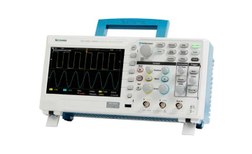
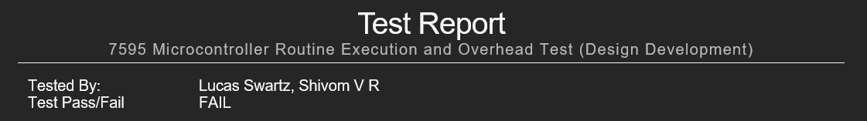
Testing
Opportunities to Learn
How tests are determined and carried out
Learned to use important tools like oscilloscopes and multimeters to debug issues in code
Ran my own experiment and wrote up extensive test report, identifying key points and results of the test
Notes:
Talk details about the routine timing test

Slide 4

Advanced Programming
Opportunities to Learn
Deepened understanding of programming languages through hands-on experience with C and Git
Began the learning process for other languages like Python
Developed both high-level and embedded code for the GeniSys controller and Raspberry Pi systems.

Slide 5
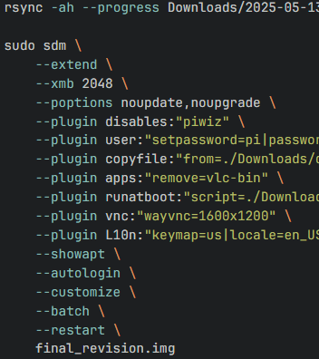
Benefits to working at R.W. Beckett
The job position directly correlates with my major
Each person here is supportive and always willing to help
Given the opportunity for a lot of personal growth towards my goals

Slide 6

Drawbacks to working at R.W. Beckett
A large part of testing was repetitive and tiresome
There was quite a bit of downtime between tasks (room for self learning)

Slide 7


Past Preparation
Current Work
Only had one year of schooling complete so I did not get as strong a skill set as other
Course at OSU were more than enough to set a foundation and let me grow throughout my internship.
Assignments are a good level of difficulty
Leave vast room for growth without being unachievable at my level

Slide 8
Knowledge I’m Taking with Me
To School
What work I need to do to reach my goals
How to work on personal projects using the skills I’ve obtained
A stronger foundation on the inner workings of various codebases
To my Career
What to look for in my future career, both professionally and socially
A plan for my future career in computer engineering by committing fully to the major

Slide 9

Advice For Upcoming
Co-Ops
Don’t Worry, everyone wants to help
No one is going to give you work that you can’t handle, even if you must learn more to complete it
Don’t fear asking for help when you need it

Slide 10
Thank You
Rick Nigro
Matthew Sessions
Shivom Raskar
And to all the Becket staff

